Slide 1
subway
summary, 21st of june

Slide 2
questions
do we represent spatial problems in a hierarchical way? how is this representation encoded in the brain?
how do we achieve goal-directed planning?

Slide 3
hypothesis
information bottlenecks
consistency (by episodic memory)
high entropy and surprise

Slide 4
method
fMRI
subway task:
hierarchy is forced as network → lines → stations
training with coloured maps
scanner with a black/white interface

Slide 5
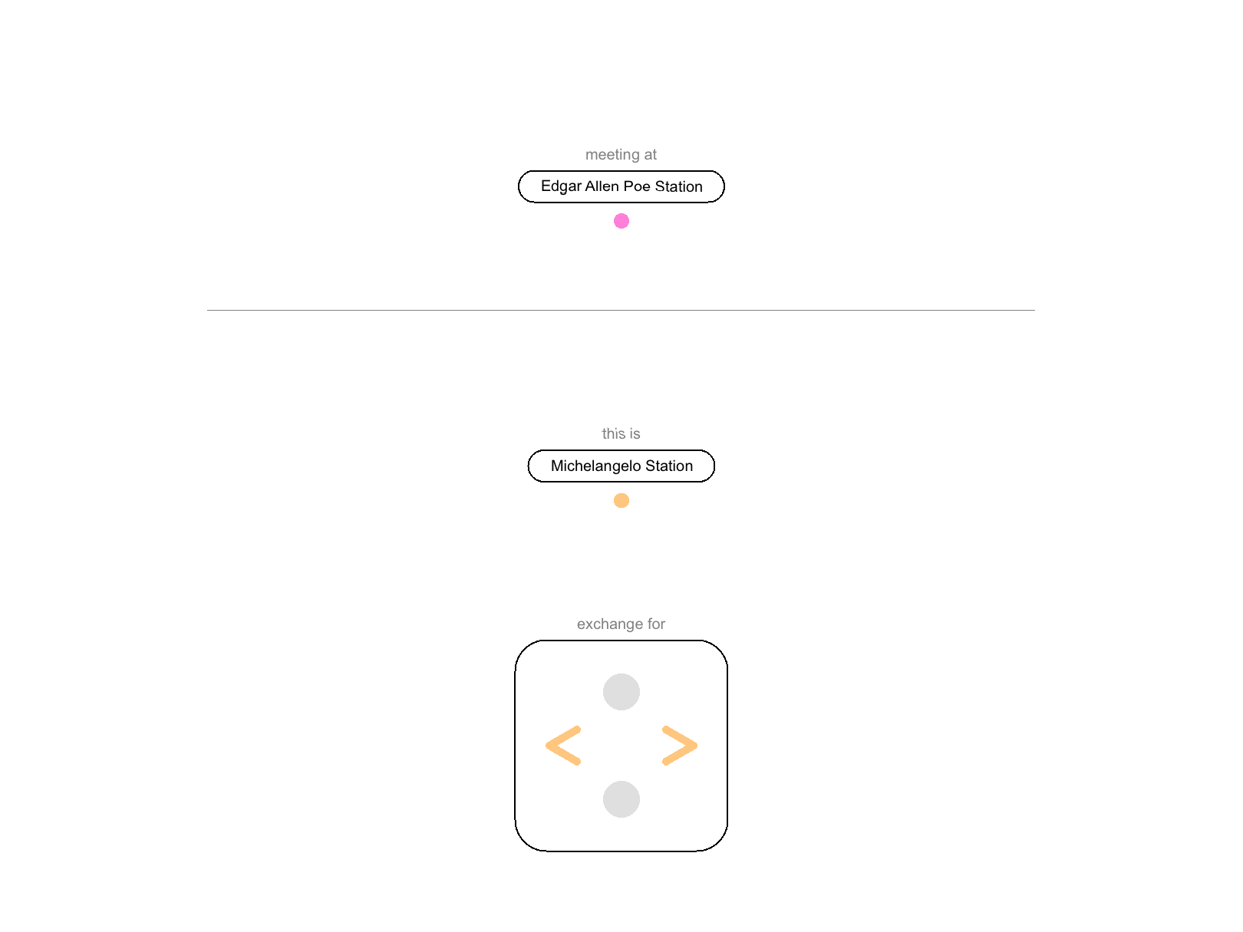
the task

Slide 6
1st pilot – 15th april
N = 5
1500 trials
750 learning
750 reward (1 or 5£ if goal achieved on time)
5 quizzes of 10 questions
from/to endpoints
randomly-generated maps

Slide 7
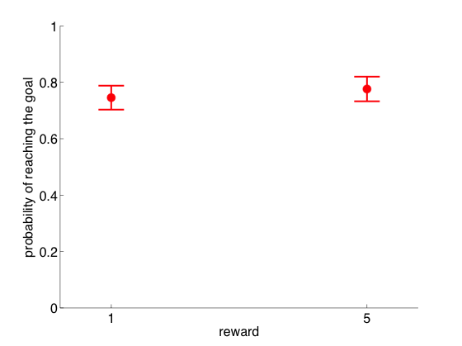
1st pilot – 15th april
No effect of reward

Slide 8
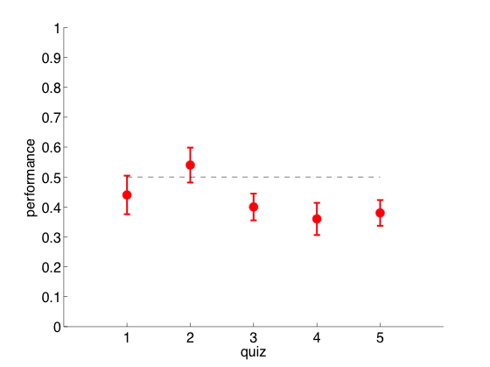
1st pilot – 15th april
No learning

Slide 9
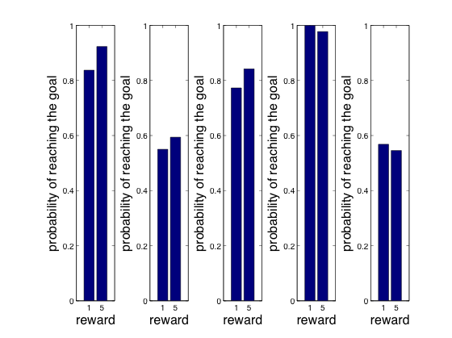
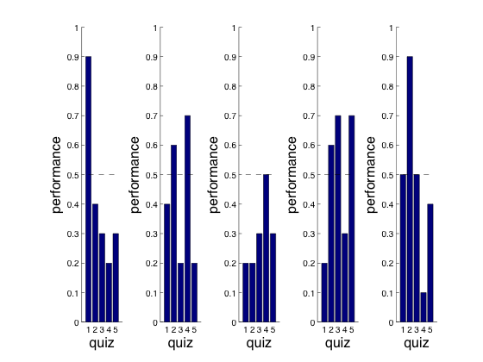
1st pilot – 15th april
Some seem to learn. Poor quizzes overall?

Slide 10
2nd pilot – 22nd april
N = 7 (1 common to the first pilot)
800 trials
400 learning
400 reward
2 quizzes of 10 questions
waiting time for switch lines

Slide 11
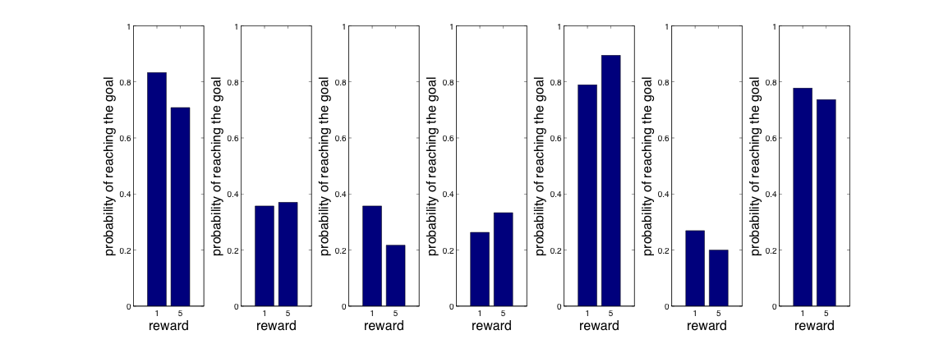
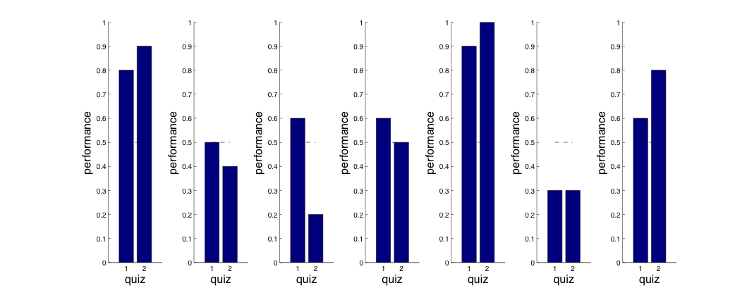
2nd pilot – 22nd april

Slide 12
2nd pilot (bis) – 24th april
N = 3 (the best from the 2nd pilot)
1000 trials
500 warm-up (colour)
400 reward (black/white)
5 quizzes of 15 questions
maps they had in their previous session

Slide 13
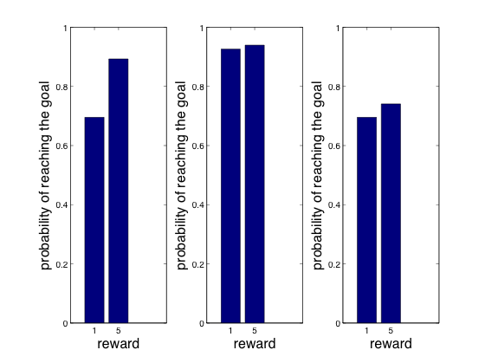
2nd pilot (bis) – 24th april
Small effect of reward?

Slide 14
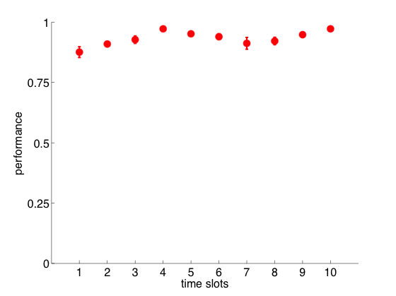
2nd pilot (bis) – 24th april
Still some learning?

Slide 15
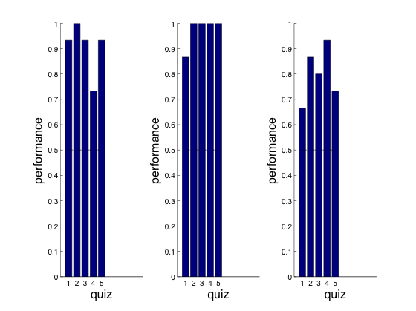
2nd pilot (bis) – 24th april
quizzes are good!

Slide 16
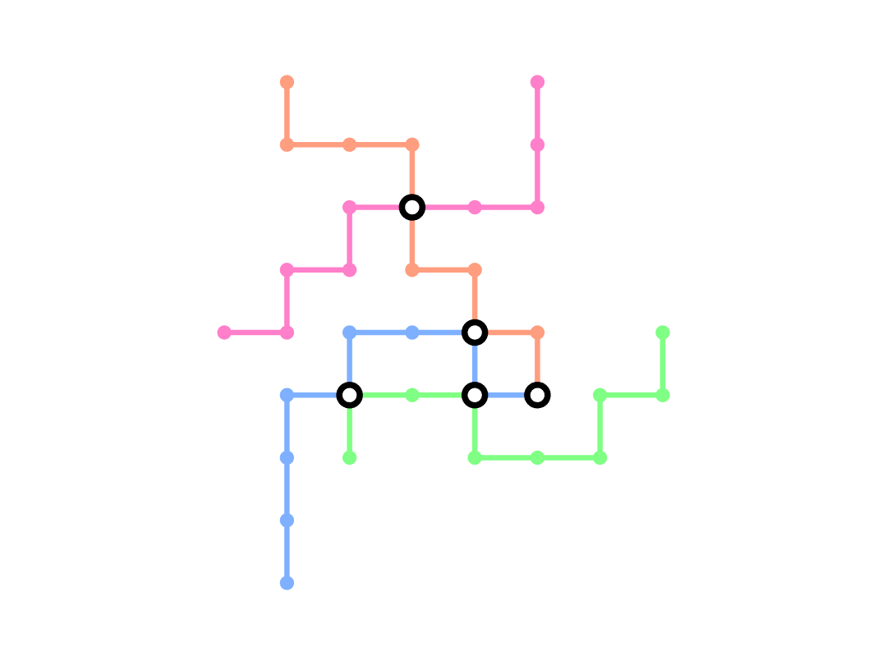
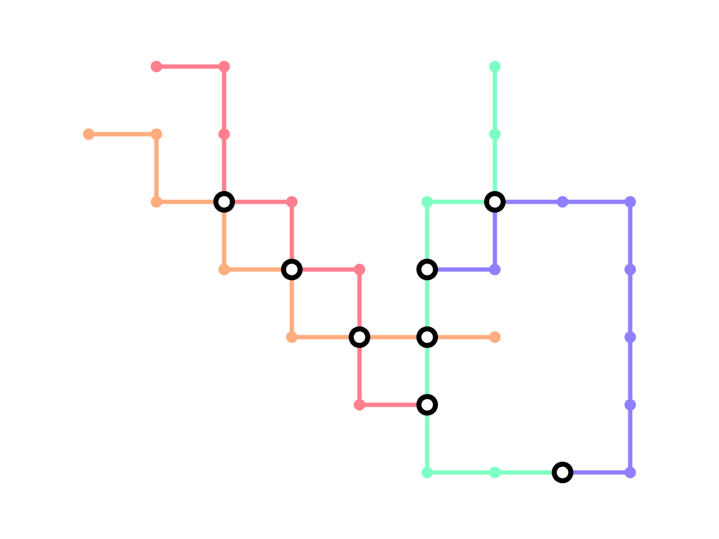
2nd pilot (bis) – 24th april

Slide 17
3rd pilot – 1st may
N = 11 (all new but 3)
1000 trials
only learning
5 quizzes of 15 questions
two maps (one from before + a new one)

Slide 18
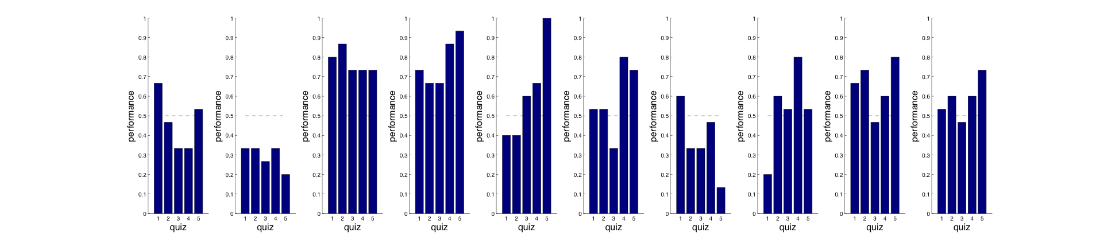
3rd pilot – 1st may
again, only some of the participants
achieve the good level of performance

Slide 19
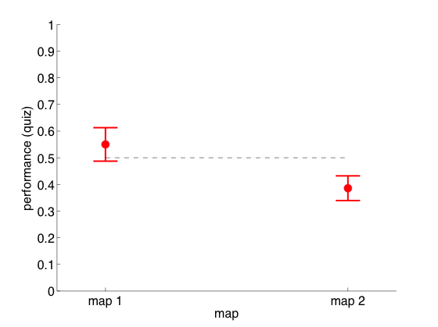
3rd pilot – 1st may
doesn't seem to be because of the kind of map

Slide 20
3rd pilot (bis) – 6th may
N = 9 (second session, after 6-21 days)
1000 trials
only learning
5 quizzes of 15 questions
(same maps)

Slide 21
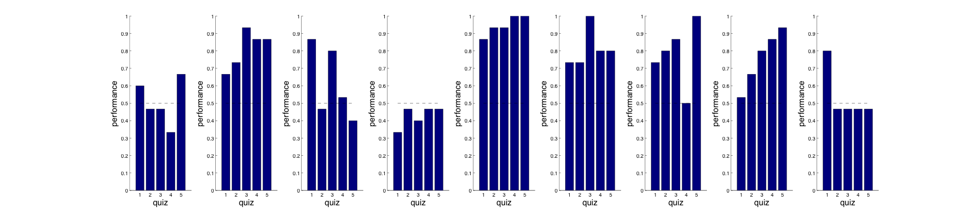
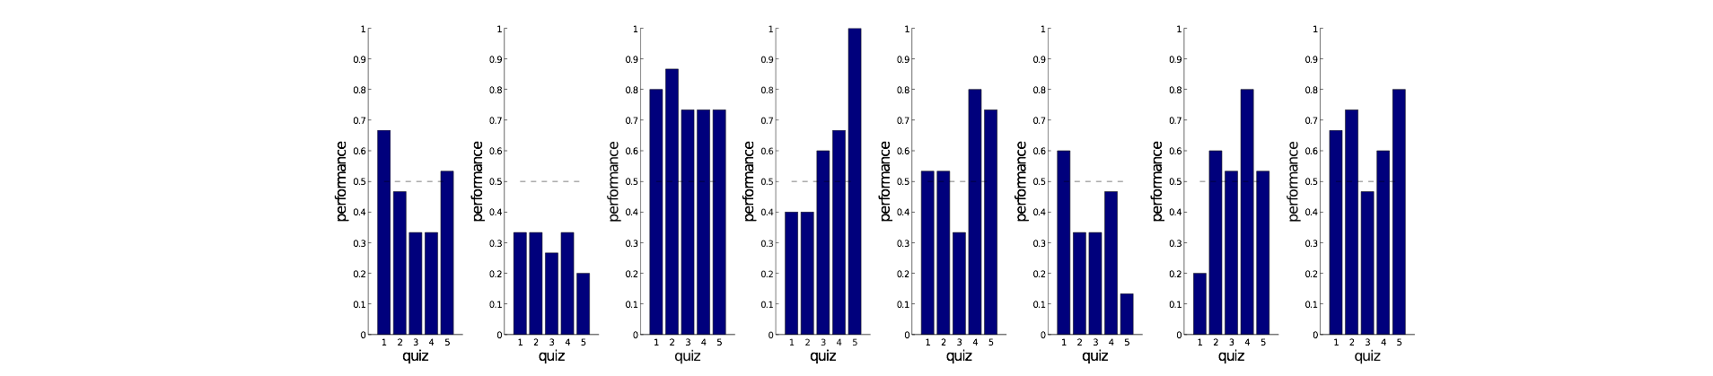
3rd pilot (bis) – 6th may
not a big improvement on the quizzes…

Slide 22
4th pilot – 29th may
N = 4 (all new)
1000 trials
only learning
one single map, hand-made
4 lines
35 stations
5 change-points
4 changes of direction
again, only 2/4 could learn the map

Slide 23
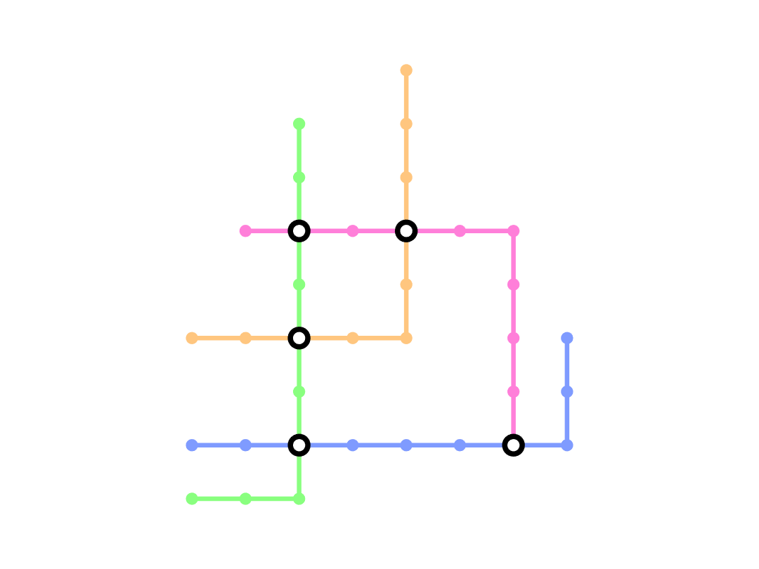
4th pilot – 29th may

Slide 24
5th pilot – 18th june
N = 6 (all ~new)
2 sessions, 50 minutes each
first session: long memory + learning
second session: short memory + learning + quizzes
one map

Slide 25
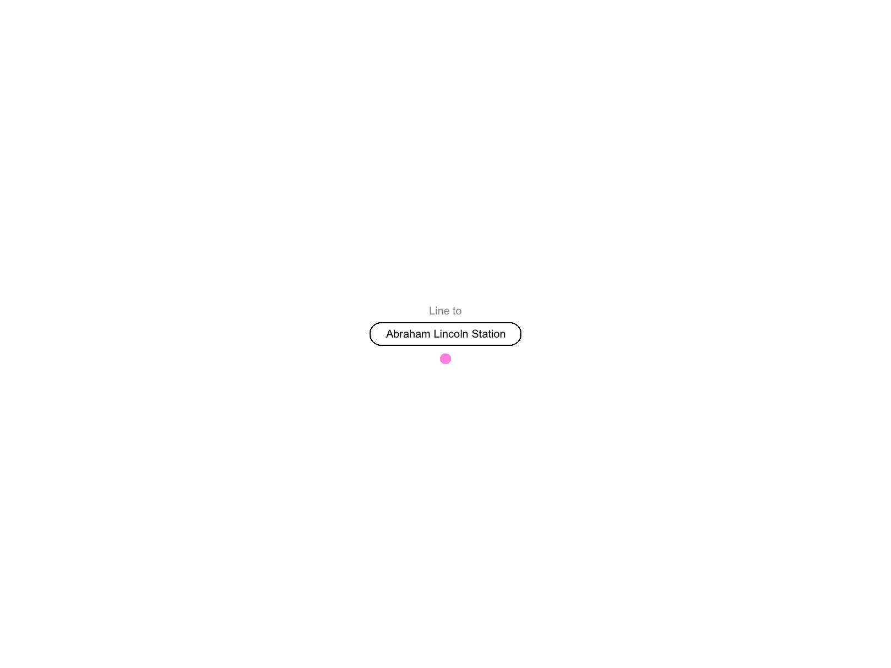

Slide 26
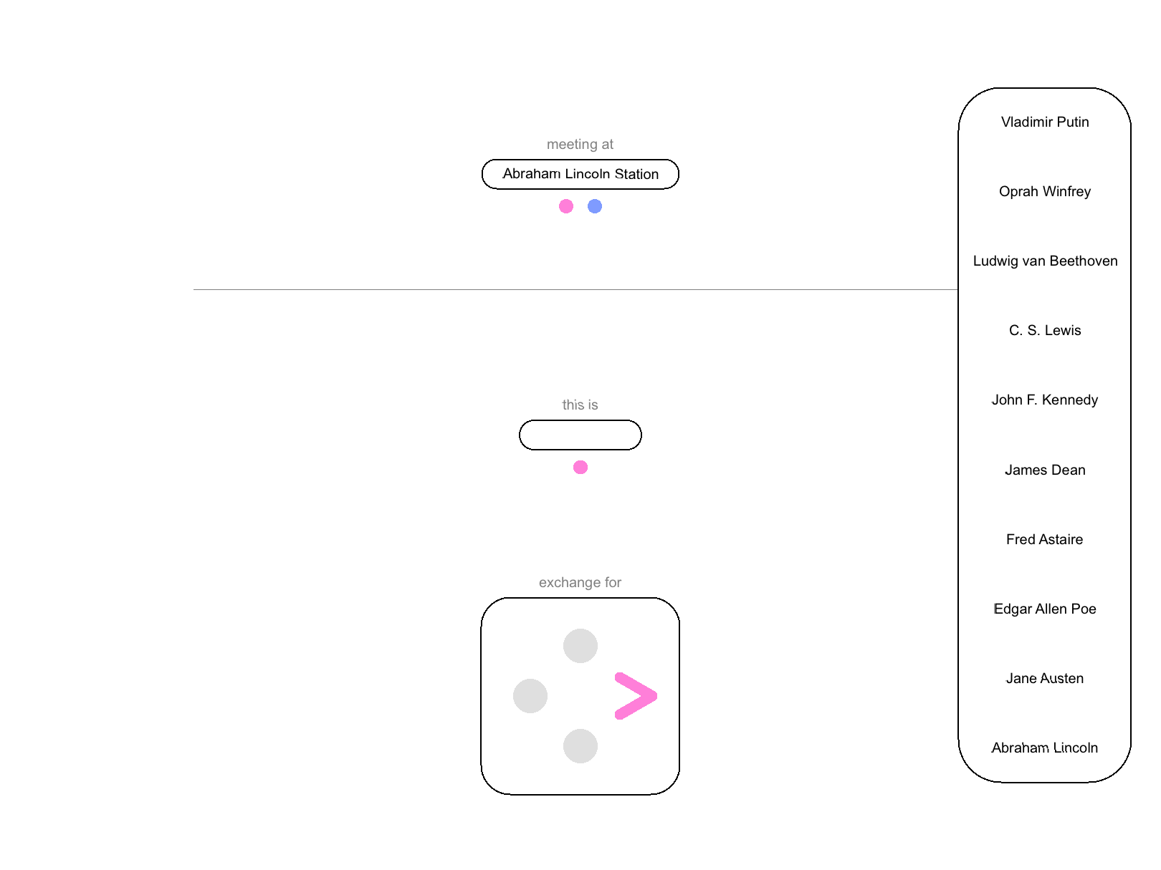

Slide 27
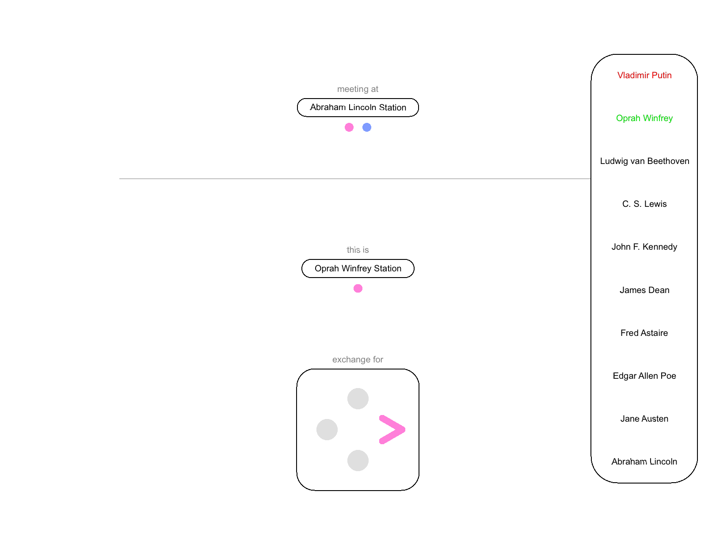

Slide 28
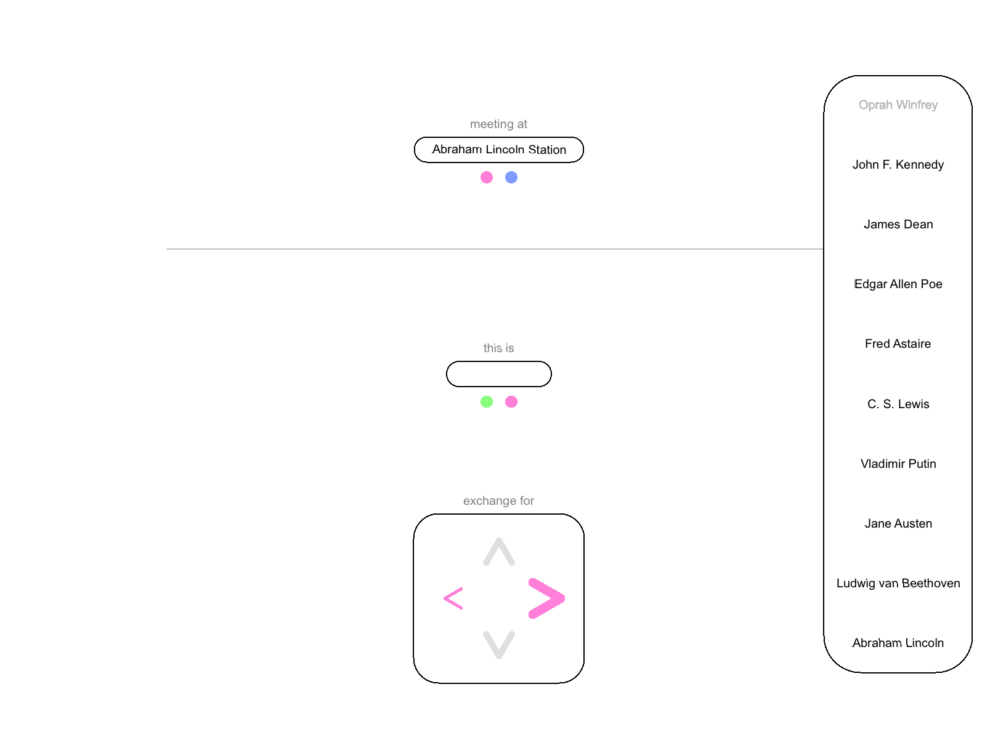

Slide 29
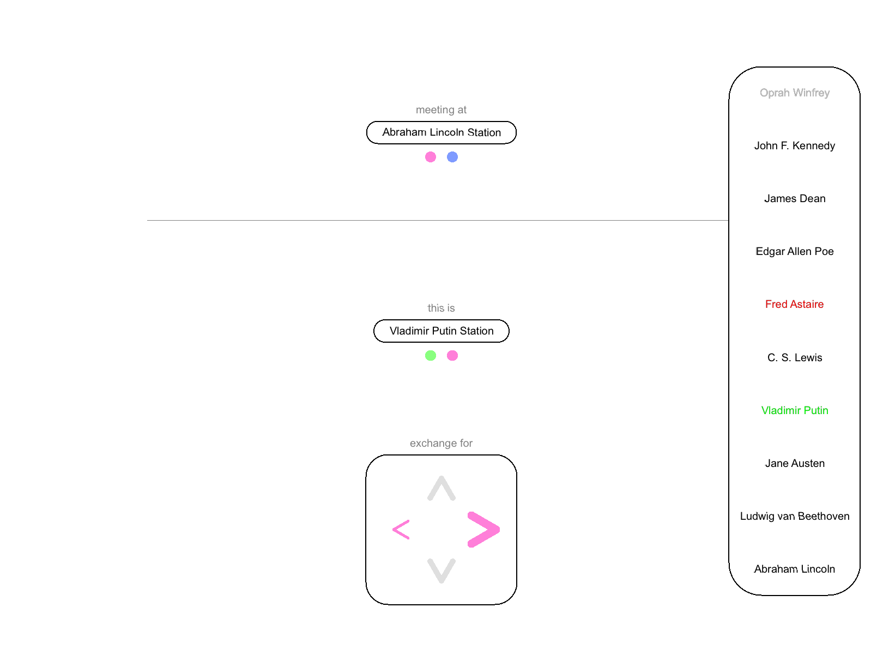

Slide 30
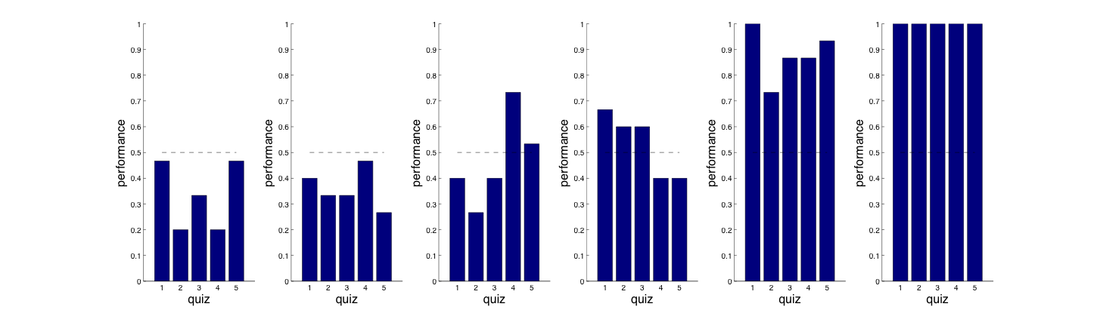
5th pilot – 18th june
again…

Slide 31
next?
maybe using only the participants who can learn the map?

